Slide 1

Intern Final Presentation
Aayush Mailarpwar
17th August 2022

Slide 2

About Me
School: Purdue School of Engineering, IUPUI
Degree: BS in Computer Engineering
Born in Australia and lived in India
Internal Use Only

Slide 3
About My Internship
Position: IT Intern
Group: Web & BI Systems
Organization: EBU IT
Manager: Manoj Abraham
Coworkers: Varun Shetty, Anthony Reno
Internal Use Only

Slide 4
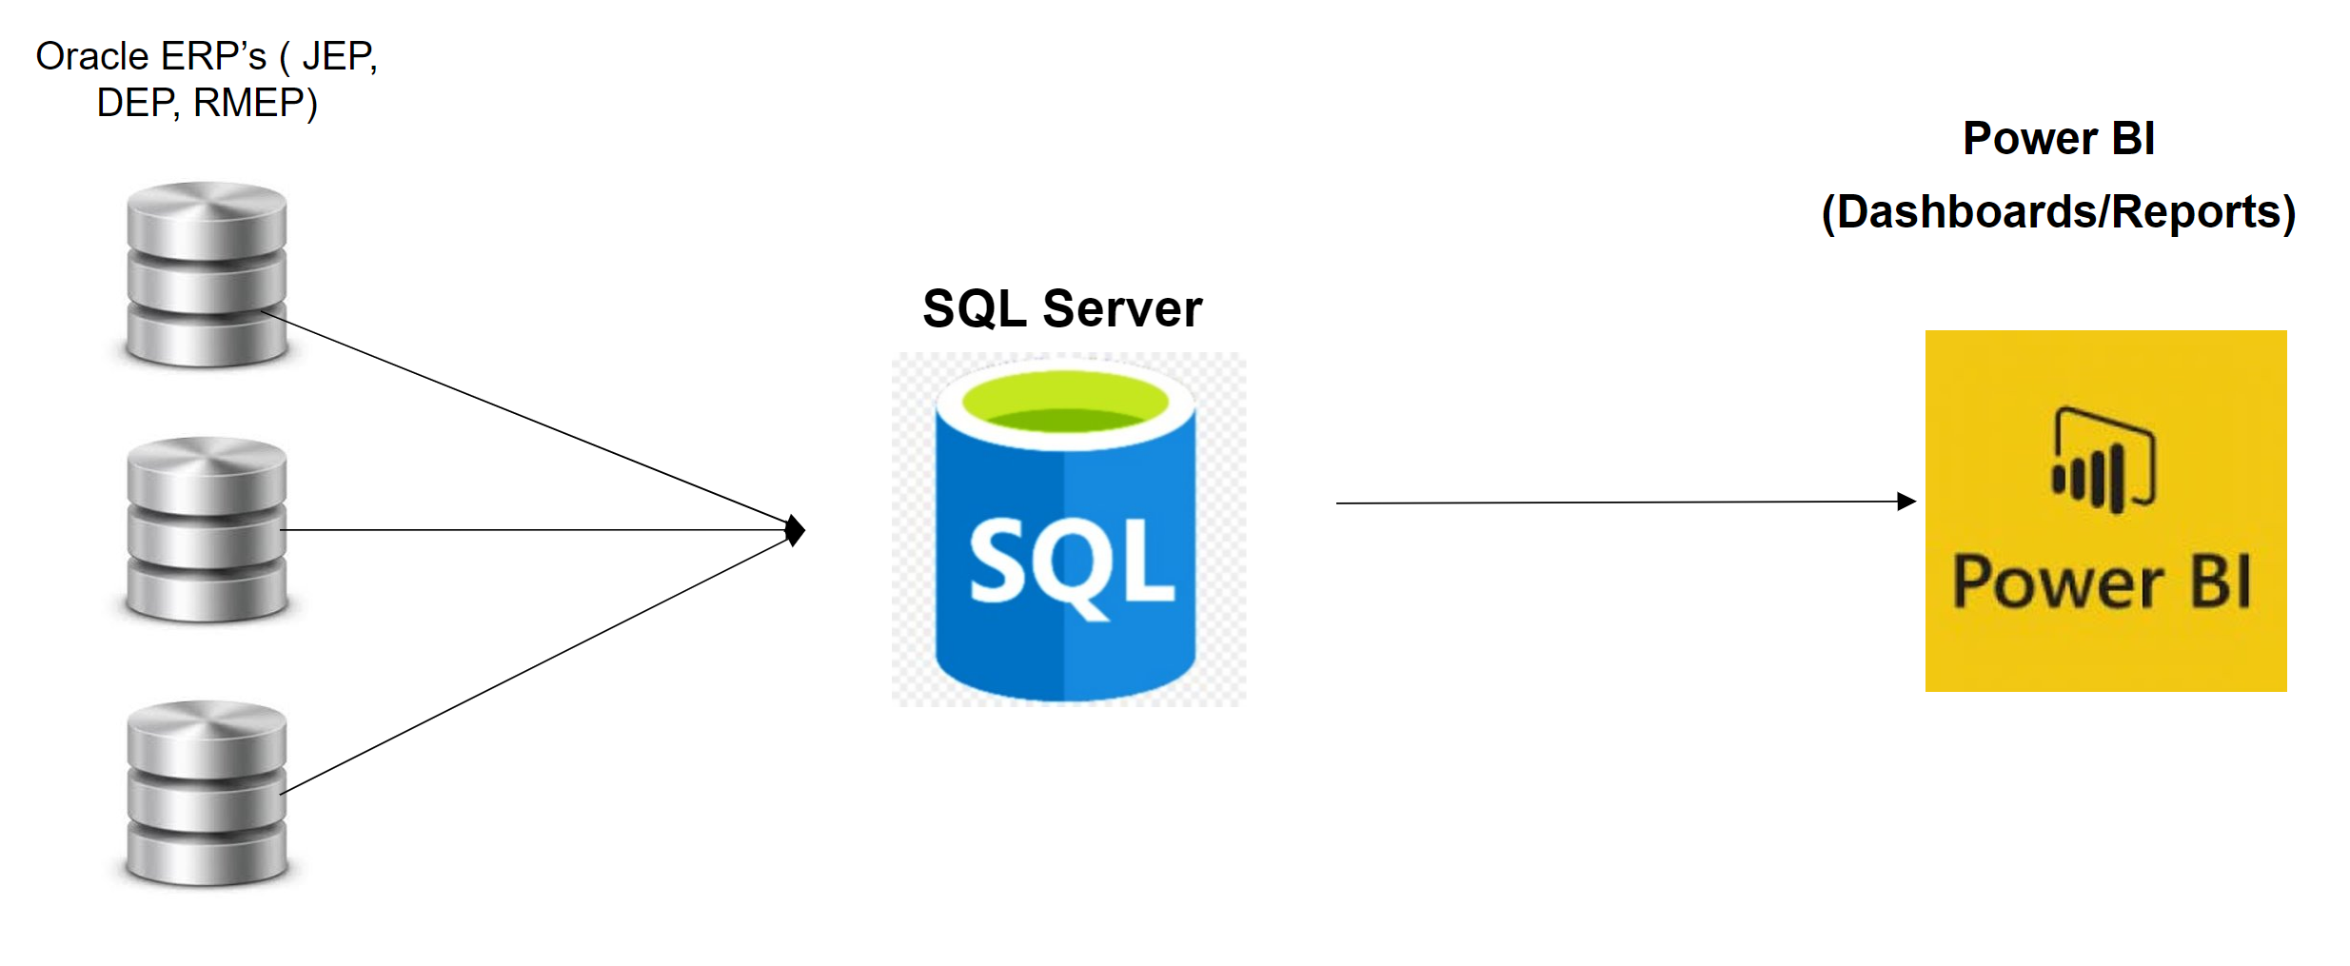
Main Project – CMEP ERP Reporting
Objective: Development of BI Reports for migration from IMS to OCI (Oracle Cloud Infrastructure)
Project Manager (Managerial Skills)
Scrum master, task assignment, providing weekly status updates to business and IT leadership
BI Developer (Technical Skills)
Used SQL Server and Oracle to create Power BI reports
Internal Use Only

Slide 5
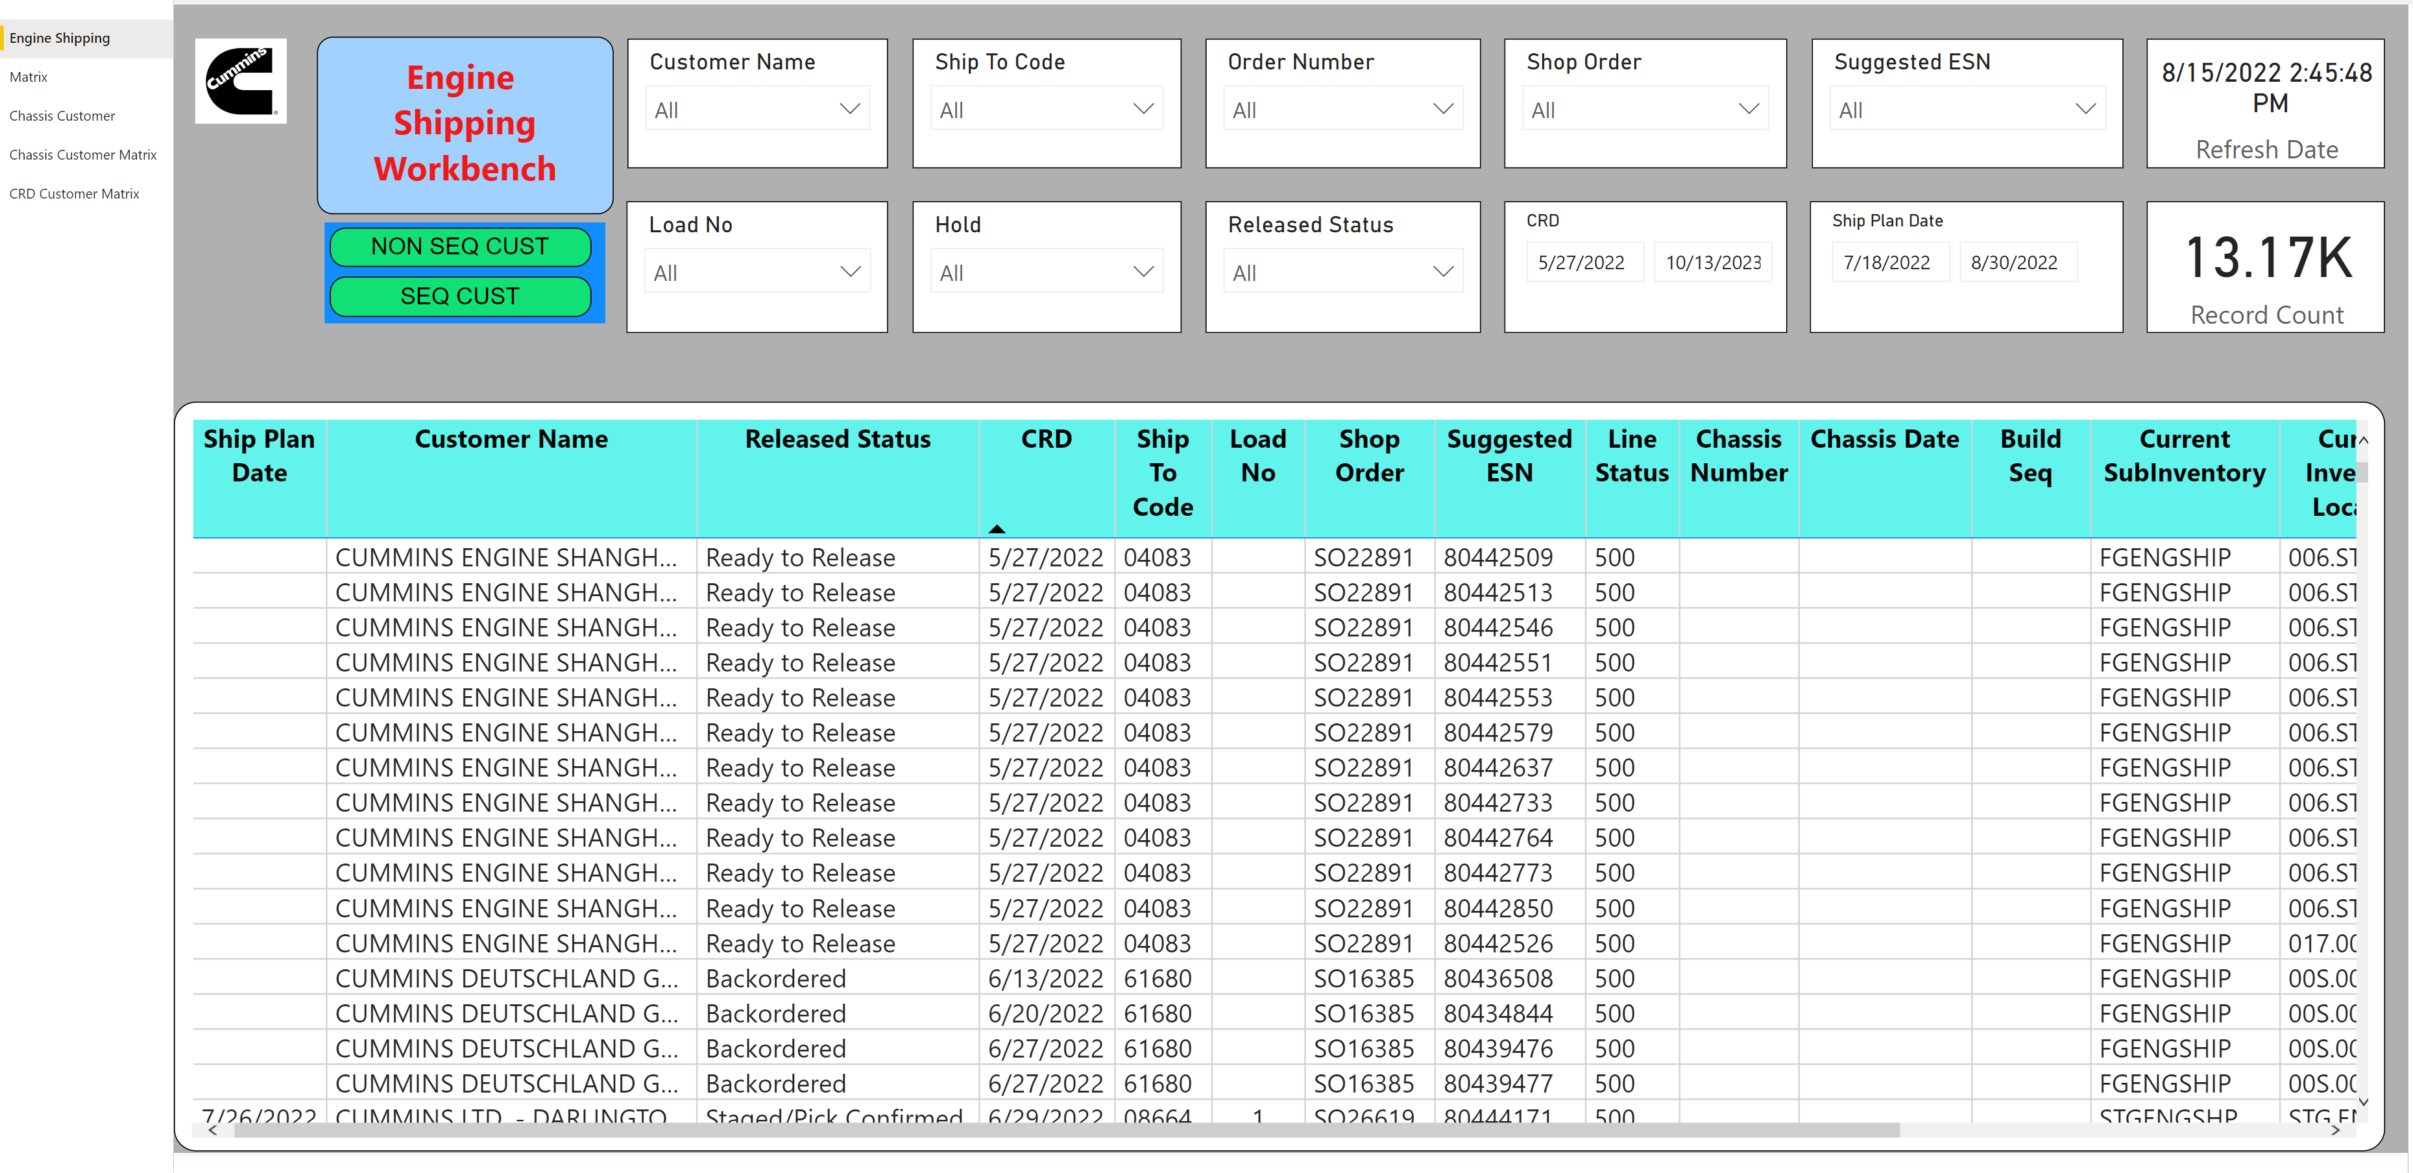
Engine Shipping Workbench

Slide 6
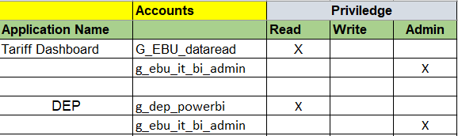
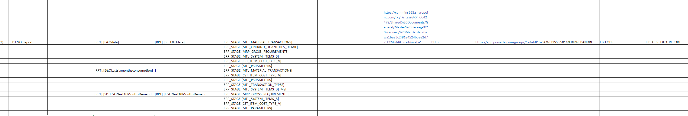
Business Continuity Plan (BCP) Report Development
Developed reports used for JEP ERP Migration
Building knowledge management tools
User access control matrix – built a repository of user access control mechanism used in various business intelligence applications owned by EBU
Report traceability matrix – this provides the necessary traceability of all objects used in building Power BI reports
Internal Use Only

Slide 7
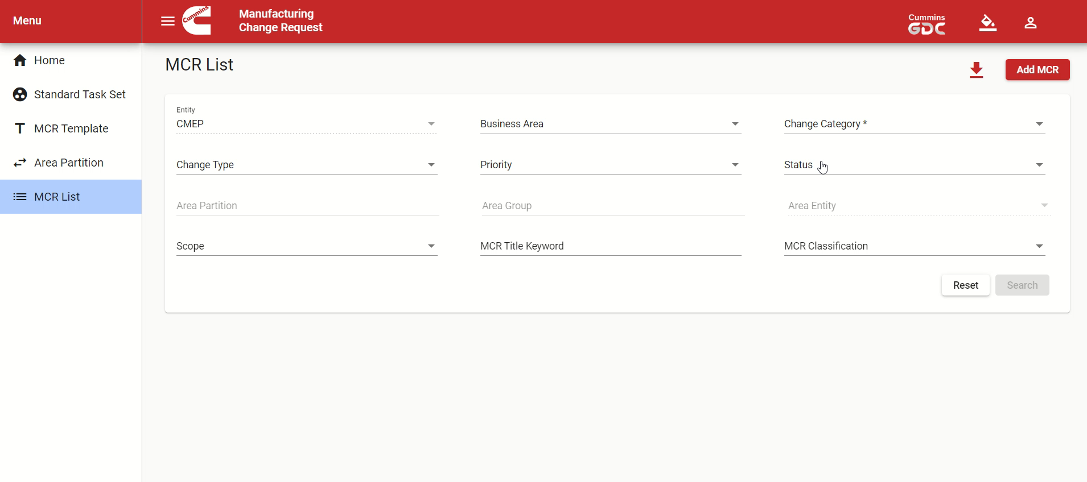
My Secondary Project
Web Development Project (MCR)
Full stack development using Angular Framework, TypeScript, Python Backend connected to an SQL Query
Enhanced the functionality of dropdown menus in MCR application which is in production for business users
Internal Use Only

Slide 8

Learning Experience
Experience as both a Developer and Leadership Skills
Networking at Cummins
Work culture at Cummins
Independence and value of work done
Underwent Agile Bootcamp training and CMI Plant visits

Slide 9


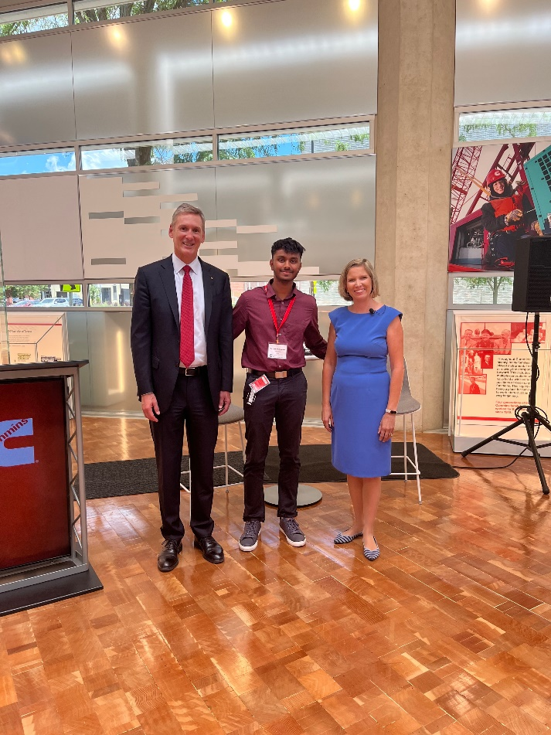
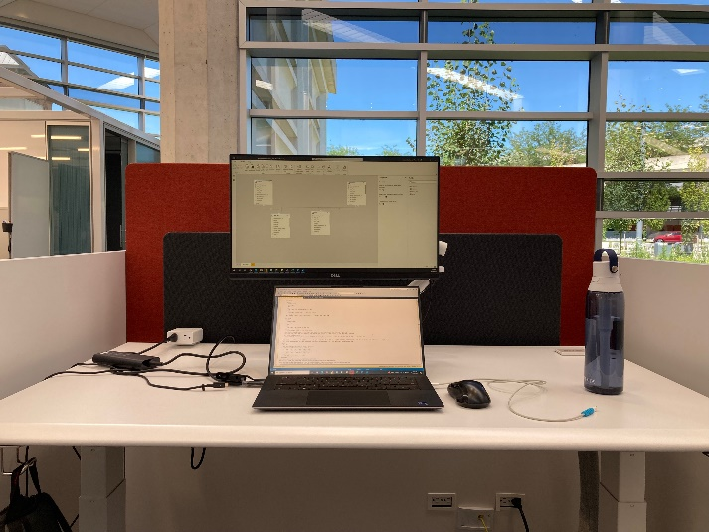
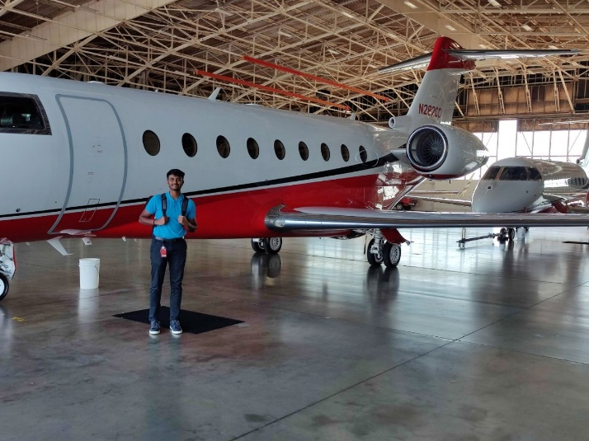
About My Summer
DBU, Indianapolis, IN
COB, Columbus, IN
Meeting the CEOs
Work set up
JEP, Jamestown, NY
Internal Use Only

Slide 10
Q+A

Slide 11



